Slide 1
Ultimate Command Line Tools
on *nix Terminals
that Booms Your Efficiency

Slide 2
如何提升你的终端工作效率
三大思想
扔掉 鼠标
扔掉 方向键
扔掉 GNU base utils

Slide 3
如何提升你的终端工作效率
五个方向
a modern shell
type faster
move faster
find faster
fancy display

Slide 4
a modern shell
zsh
oh my zsh
p10k theme
plugins
git sudo colored-man-pages
zsh-autosuggestions & zsh-syntax-highighting

Slide 5
a modern shell
zsh
plugins
example: calc
https://github.com/arzzen/calc.plugin.zsh
zsh plugins collection
https://github.com/unixorn/awesome-zsh-plugins
fish - a pre-customized zsh

Slide 6
type faster
use alias
.zshrc
.gitconfig
shell functions
keybindings & vi-mode – line editing

Slide 7
line editing - keybindings
type faster

Slide 8
line editing – vi-mode
type faster

Slide 9
move faster
jumping around
z zoxide z.lua autojump fasd
https://github.com/rupa/z
https://github.com/ajeetdsouza/zoxide
https://github.com/skywind3000/z.lua
https://github.com/wting/autojump
https://github.com/clvv/fasd
integrate with zsh/omz

Slide 10
move faster
terminal file explorer & manager - ranger
https://github.com/ranger/ranger
vim-inspired: hjkl-style + 三栏界面
基本文件操作：增改删查
显示隐藏文件 快速选择 排序 过滤
git-status / dir flattening (:flat 1) / bulkrename
entering shell everywhere

Slide 11
move faster
ranger
自定义命令
zoxide integration
plugins
devicons – need nerd fonts
archives – 快速解压缩
integrate zoxide
others: GNU midnight commander (old)
others: nnn (unorthodox)
https://github.com/jarun/nnn

Slide 12
find faster
tldr & cht.sh
https://github.com/tldr-pages/tldr
https://github.com/chubin/cheat.sh
fd (find alternative)
https://github.com/sharkdp/fd
50 times faster
find vs fd ~ -iregex '.*[0-9]\.jpg$’
7.236s vs 811.6 ms

Slide 13
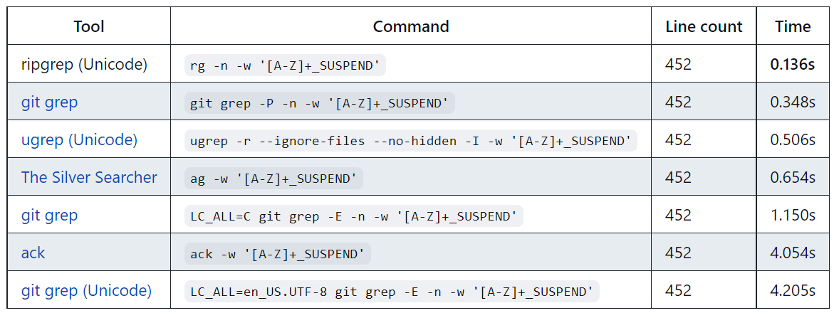
find faster
ripgrep (grep alternative)
https://github.com/BurntSushi/ripgrep

Slide 14
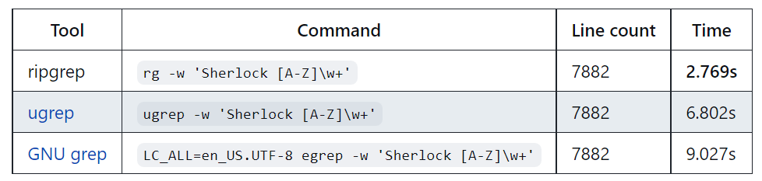
find faster
ripgrep (grep alternative)
the_silver_searcher https://github.com/ggreer/the_silver_searcher

Slide 15
find faster
ripgrep-all
https://github.com/phiresky/ripgrep-all
过滤文件内容
在巨大一堆东西里找文本
代码、PDF内容、docx、电子书、压缩包里的东西
甚至是图片（OCR）、歌词、视频字幕

Slide 16
find faster
fzf
fuzzy finder (or filter)
cat .zshrc | fzf
vim $(fzf)
integrate with zsh
ctrl-r ctrl-t (with fd) alt-c
fuzzy completion: ** ~~ (dirs, ssh, kill)
git

Slide 17
find faster
fzf
integrate with ranger (fz)
integrate with ripgrep-all

Slide 18
find faster
alacritty – search and vimode
gpu acceleration (tree)
cross platform (opengl)
auto copy
search in terminal
vimode

Slide 19
alacritty - search in terminal
find faster

Slide 20
alacritty - vi-mode
find faster

Slide 21
fancy display
bat (cat alternative)
https://github.com/sharkdp/bat
diff so fancy
https://github.com/so-fancy/diff-so-fancy
termscp https://github.com/veeso/termscp
exa logo-ls colorls (ls alternative)
https://github.com/ogham/exa
https://github.com/Yash-Handa/logo-ls
https://github.com/athityakumar/colorls
lazygit (not recommended personally)
https://github.com/jesseduffield/lazygit

Slide 22
ending
关于工具集：
不要盲从 适合最重要
不要懒惰 完整读文档
我的配置文件 仅供参考：
https://github.com/martinits/dotfiles

